Slide 1
7.강 Deep Q-learning

Slide 2
Contents
Review:
Neural Network
Pytorch
Deep SARSA
Code Exercise
Deep Q-learning
Code Exercise

Slide 3
Neural Network

Slide 4
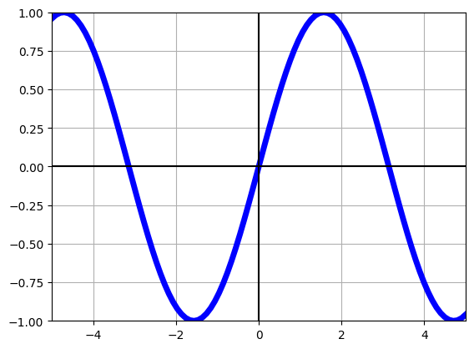
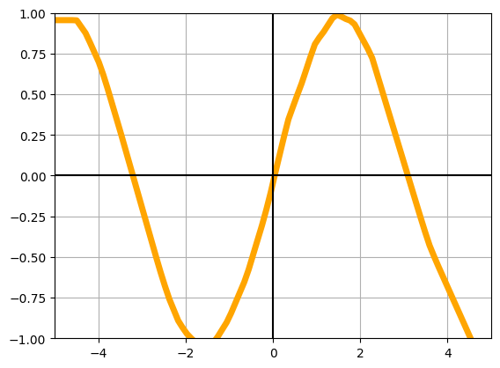
Function approximators
V(s)
V(s)
s
s

Slide 5
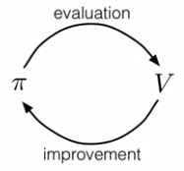
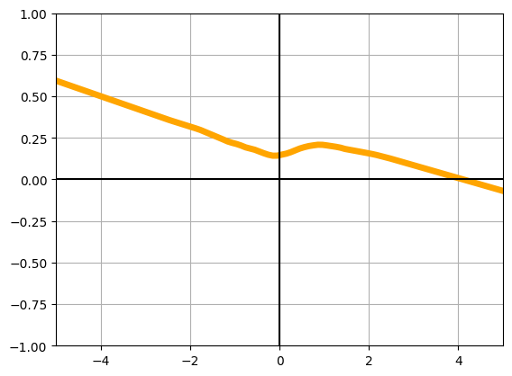
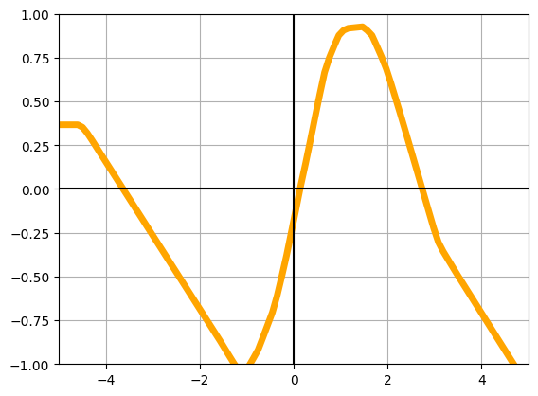
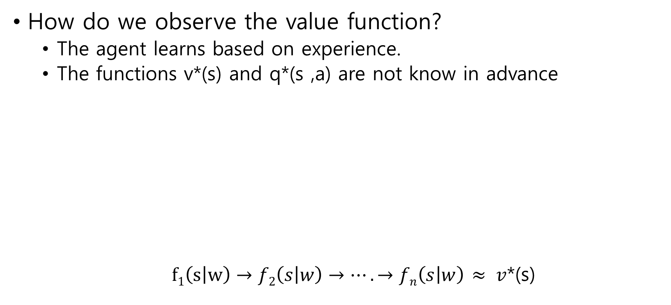
Function approximators
How do we observe the value function?
The agent learns based on experience.
The functions v*(s) and q*(s ,a) are not know in advance
$f1\left(s | w\right)→f2\left(s | w\right)→….→fn\left(s | w\right)$ $≈ v$*(s)
Policy
V(s)
Policy
s
s
s

Slide 6
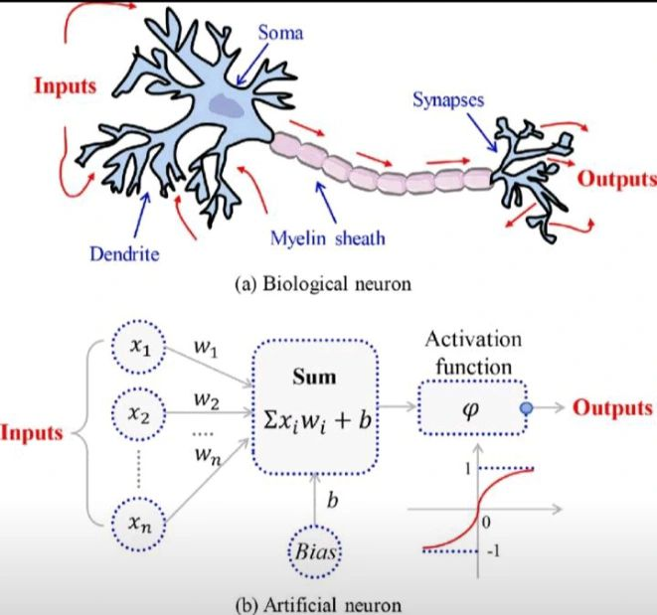
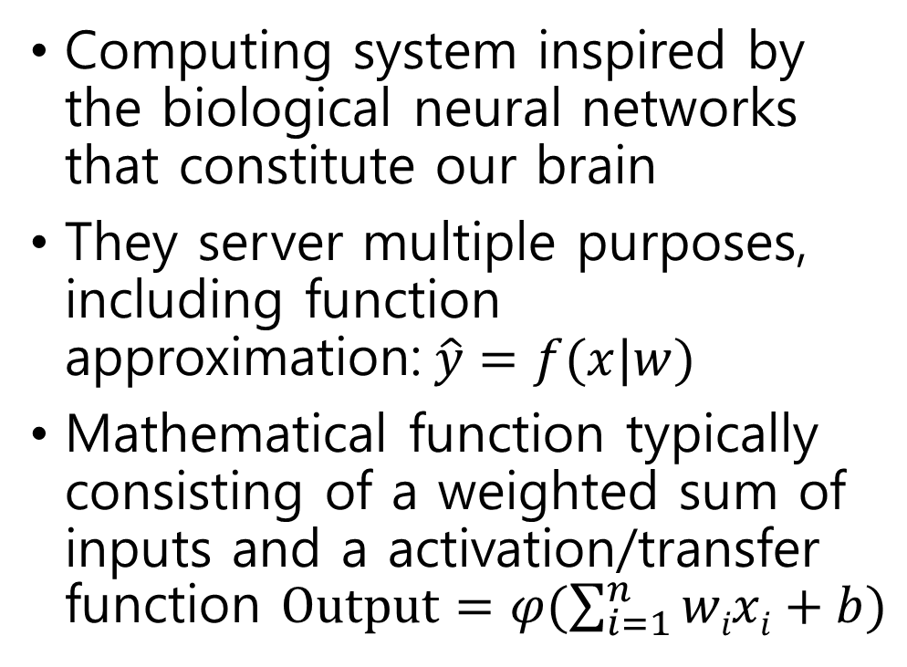
Neural Networks
Computing system inspired by the biological neural networks that constitute our brain
They server multiple purposes, including function approximation:$\hat{y}=f(x|w)$
Mathematical function typically consisting of a weighted sum of inputs and a activation/transfer function $Output=φ(\sum_{i=1}^{n}{wixi}+b)$

Slide 7
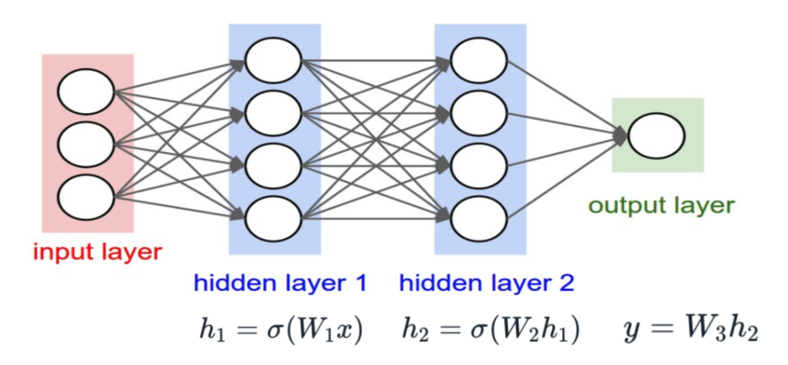
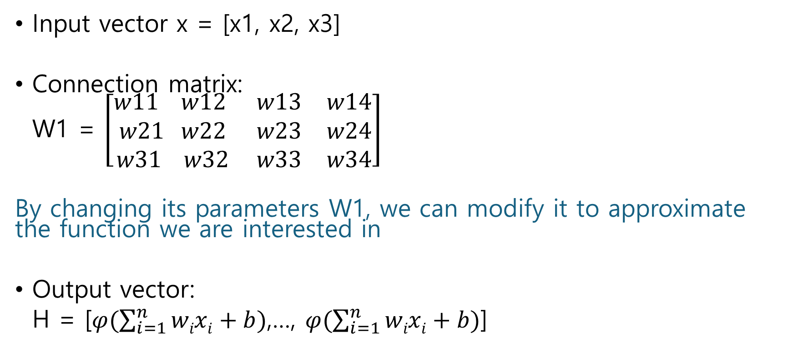
Neural networks
Input vector x = [x1, x2, x3]
Connection matrix:
W1 = $\left[\begin{matrix}w11 w12 & w13 & w14 \\ w21 w22 & w23 & w24 \\ w31 w32 & w33 & w34\end{matrix}\right]$
By changing its parameters W1, we can modify it to approximate the function we are interested in
Output vector:
H = [$φ(\sum_{i=1}^{n}{wixi}+b)$,…, $φ(\sum_{i=1}^{n}{wixi}+b)$]

Slide 8
Neural Networks
Networks that do not have cycles are known as feedforward NN. Signals always propagate forward
The neuron receives inputs, process & aggregate those inputs, and either inhibits or amplifies before passing the signal to the next layer

Slide 9
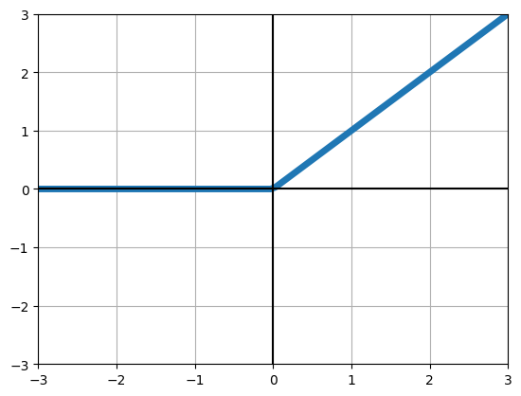
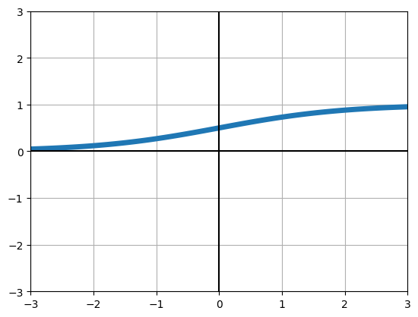
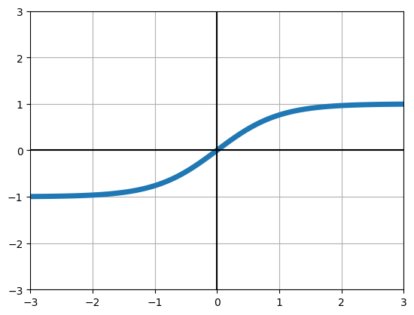



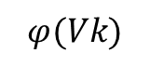
Neural networks
Activation functions
Relu()
Sigmoid()
Tanh()
$$φ(Vk)$$
$$Vk$$
$$Vk$$
$$Vk$$

Slide 10
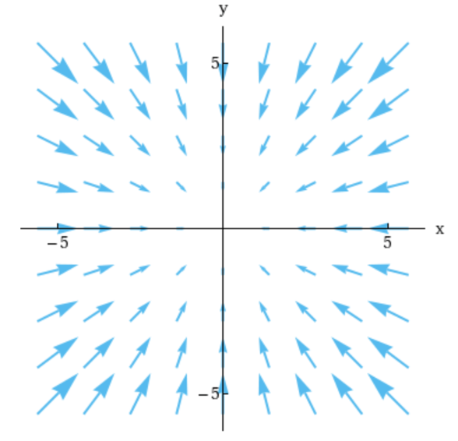
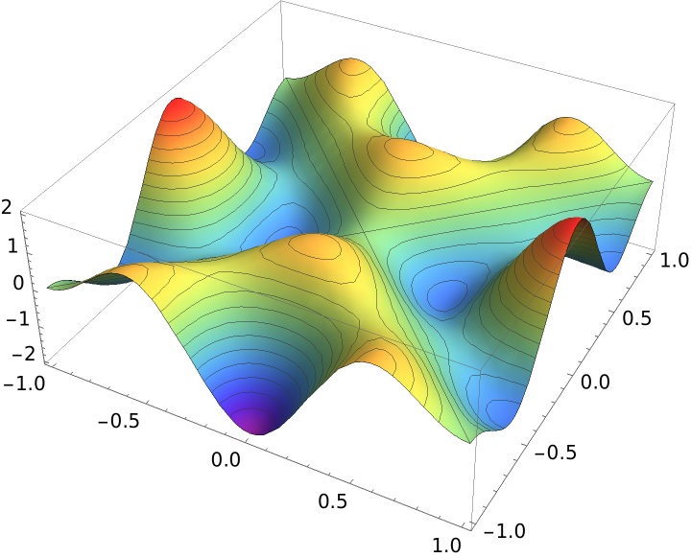
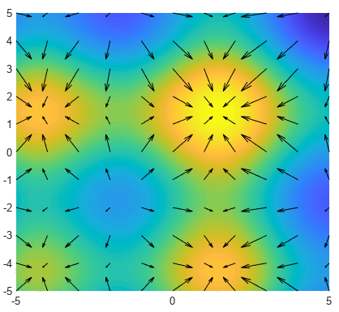
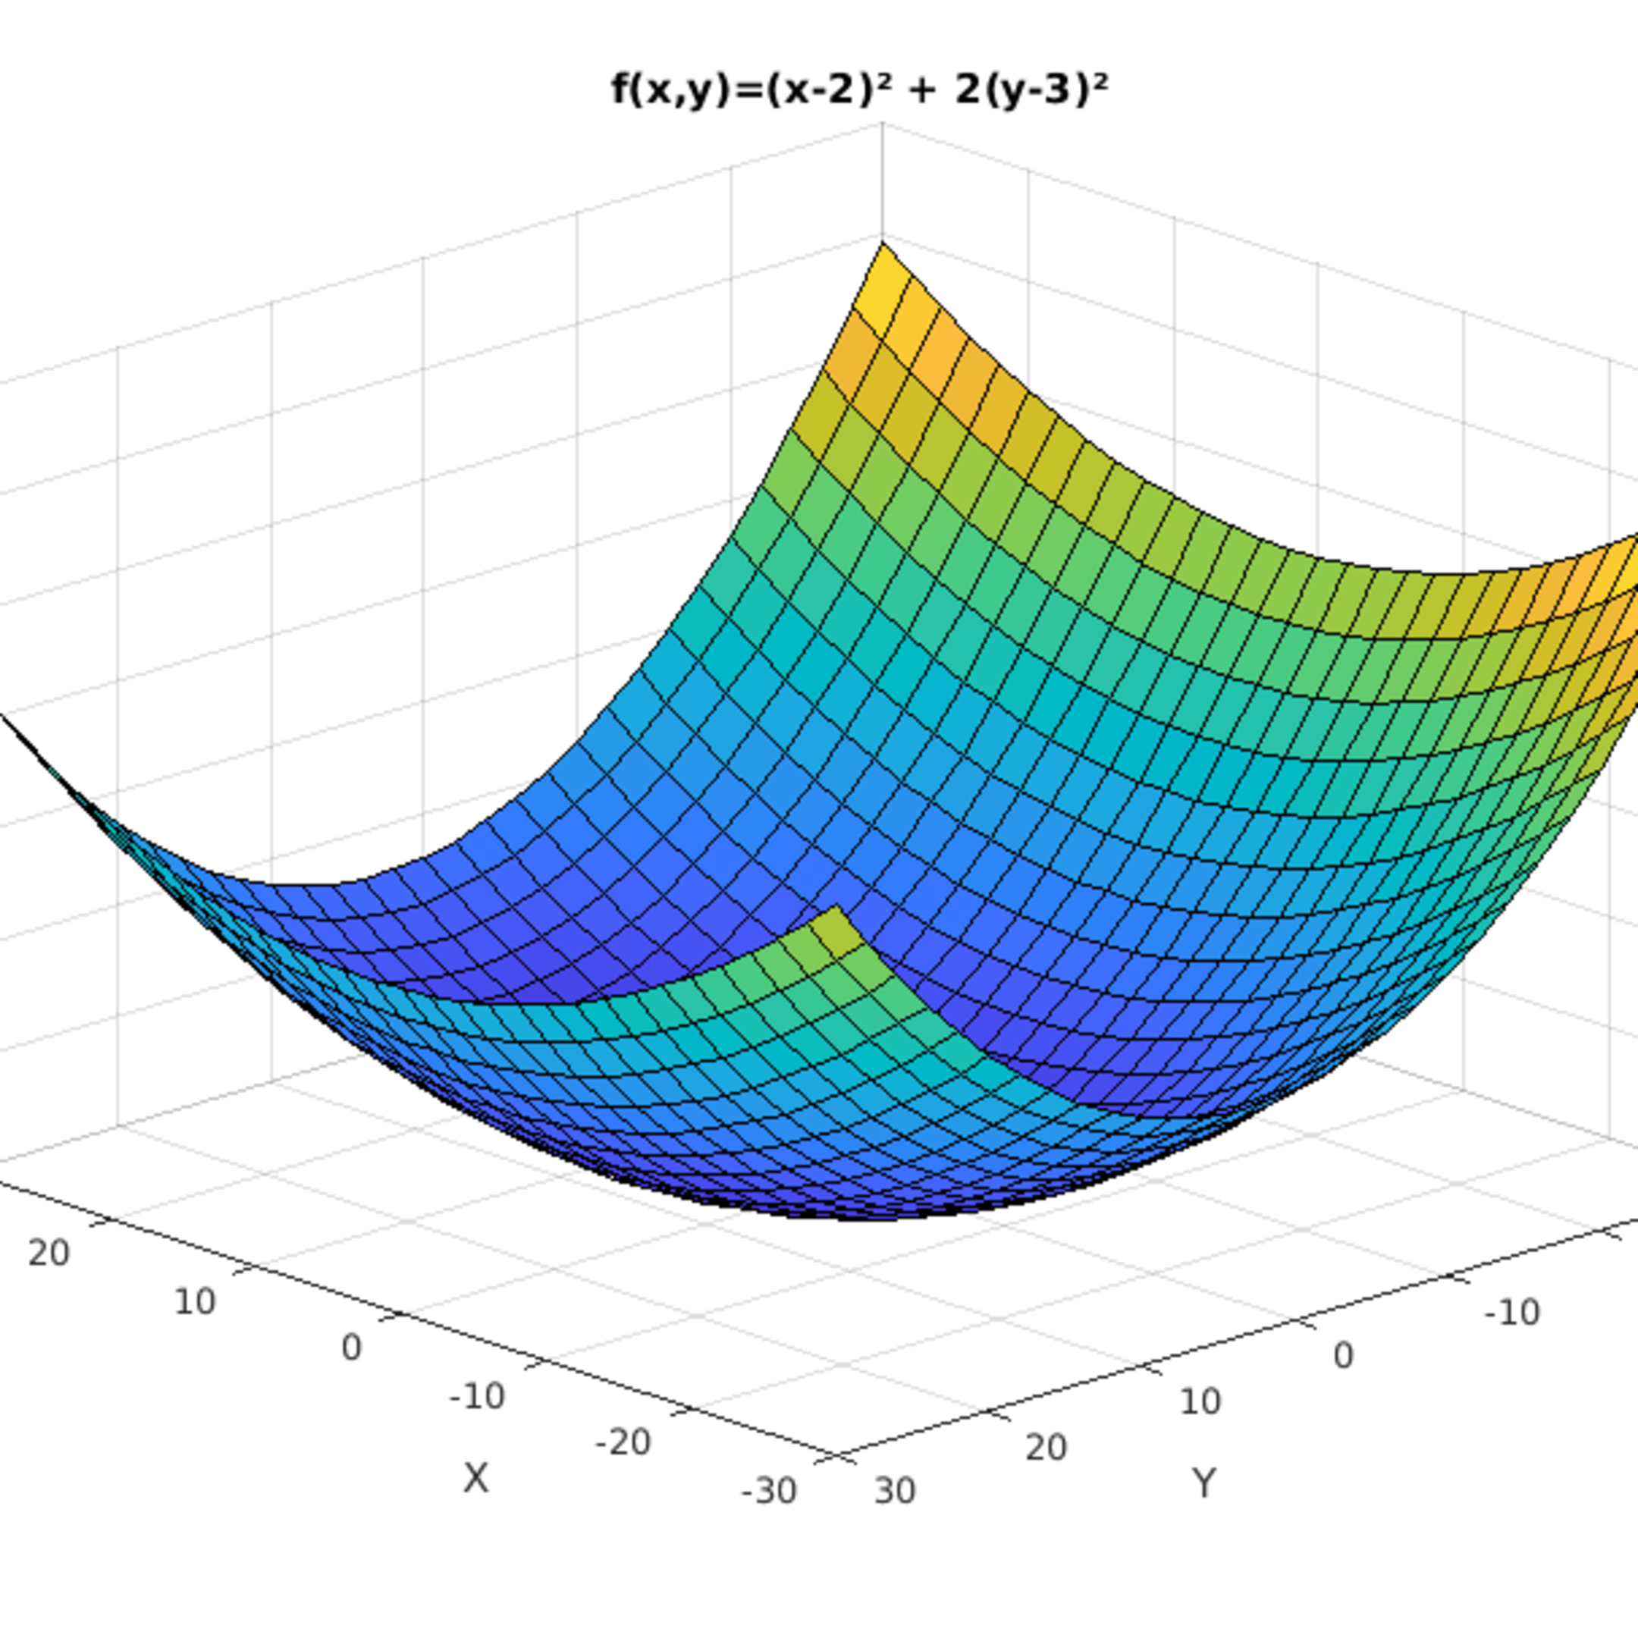
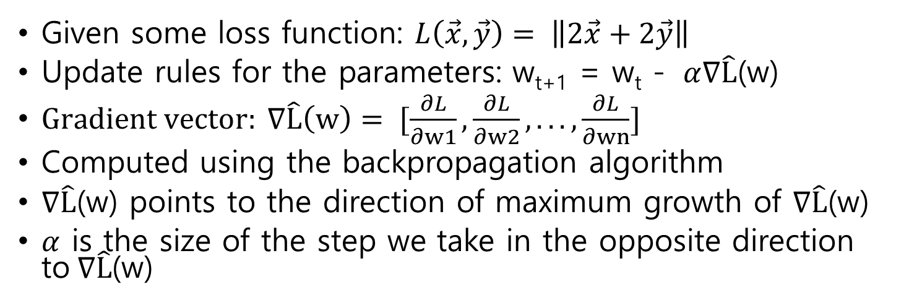
Gradient Descent
Given some loss function: $L\left(\vec{x},\vec{y}\right)= \left\|2\vec{x}+2\vec{y}\right\|$
Update rules for the parameters: w_{t+1} = w_{t} - $α∇\hat{L}$(w)
$Gradient vector: ∇\hat{L}\left(w\right)= [\frac{∂L}{∂w1},\frac{∂L}{∂w2},...,\frac{∂L}{∂wn}]$
Computed using the backpropagation algorithm
$∇\hat{L}$(w) points to the direction of maximum growth of $∇\hat{L}$(w)
$α$ is the size of the step we take in the opposite direction to$∇\hat{L}$(w)

Slide 11
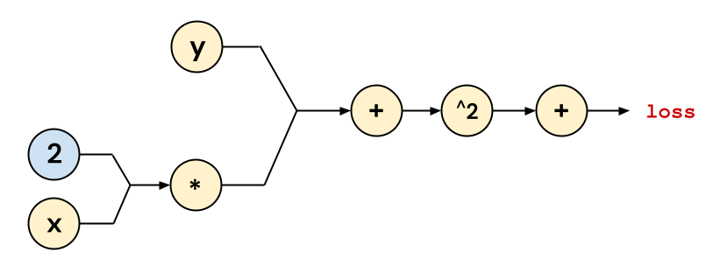
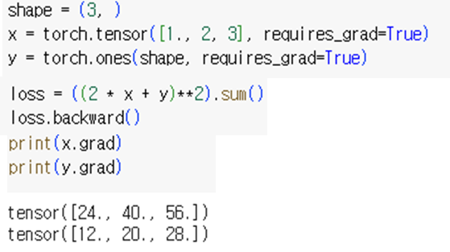
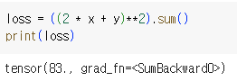
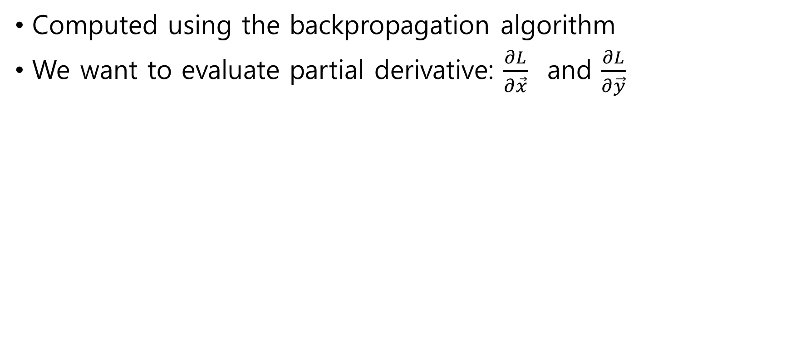
Backpropagation
Computed using the backpropagation algorithm
We want to evaluate partial derivative: $\frac{∂L}{∂\vec{x}}$ and $\frac{∂L}{∂\vec{y}}$

Slide 12
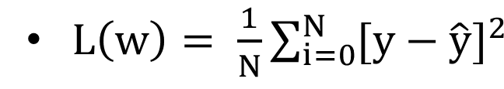
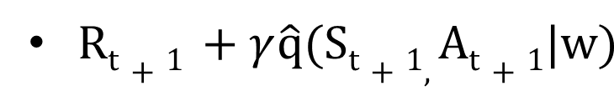
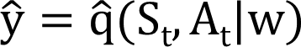
Cost function
Mean squared error:
For our neural network to estimate q(s, a) as well as possible, we will minimize the observed squared errors
Target value: Estimated value:

Slide 13
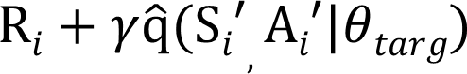
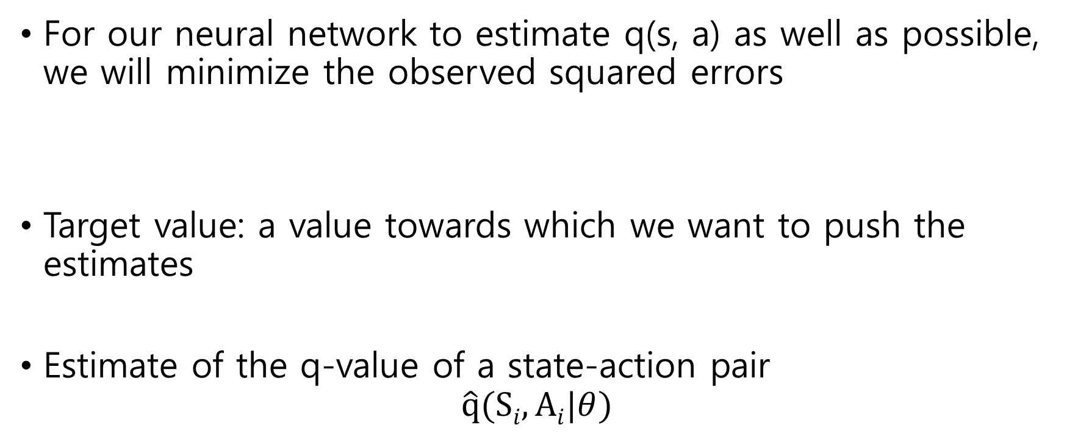
Neural network optimization
For our neural network to estimate q(s, a) as well as possible, we will minimize the observed squared errors
Target value: a value towards which we want to push the estimates
Estimate of the q-value of a state-action pair
$$\hat{q}(Si, Ai|θ)$$

Slide 14
Pytorch
Pictures from Stanford’s CS231n
Pictures from Berkeley CS285

Slide 15
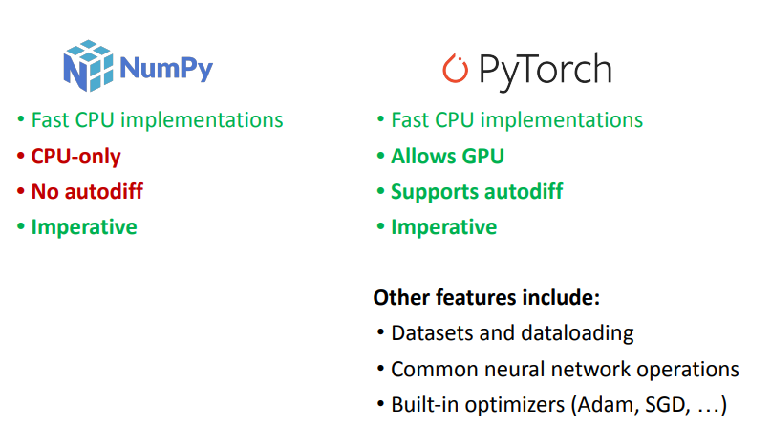
Numpy & PyTorch

Slide 16
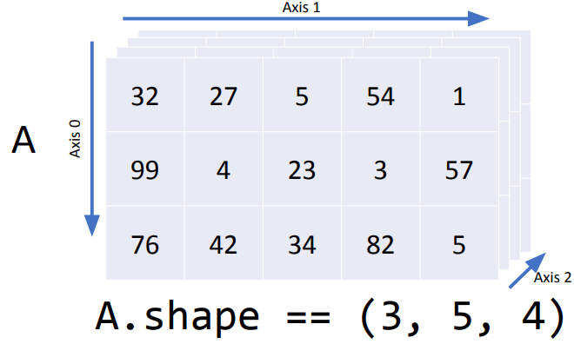
Multidimensional Indexing

Slide 17
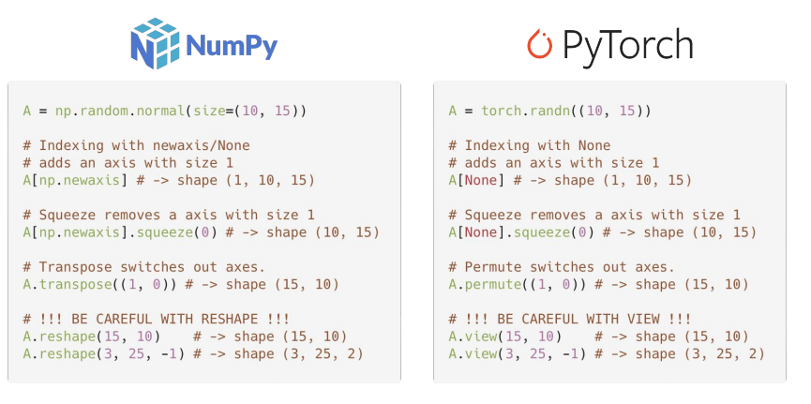
Shape Operations

Slide 18
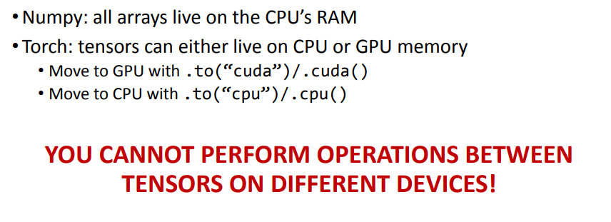
Device Management

Slide 19
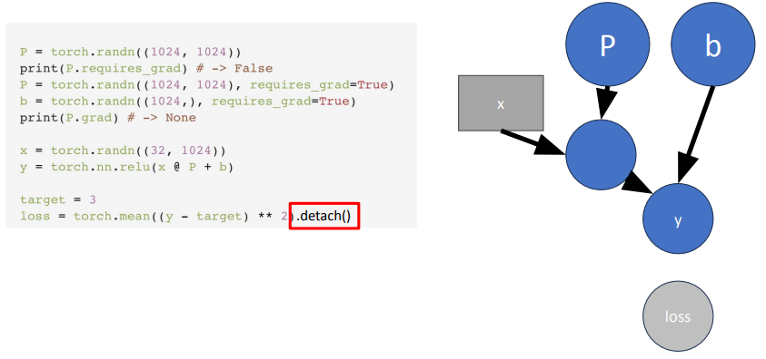
Computing Gradients

Slide 20
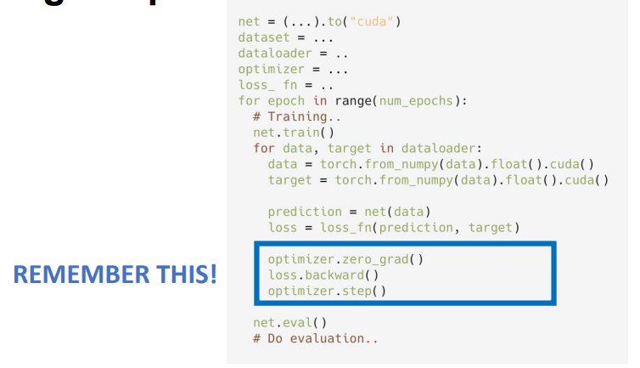
Training Loop

Slide 21
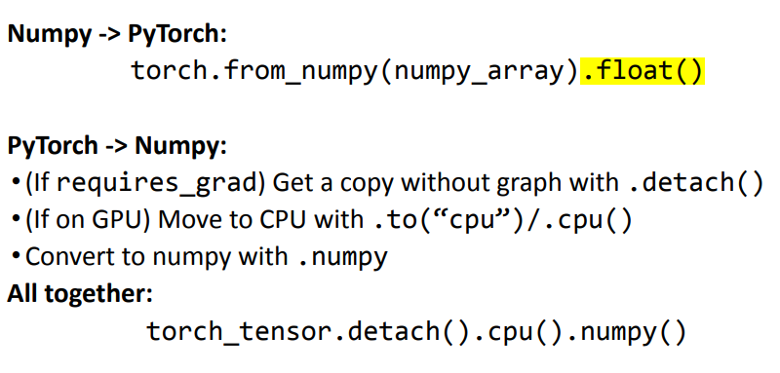
Converting Numpy / PyTorch

Slide 22
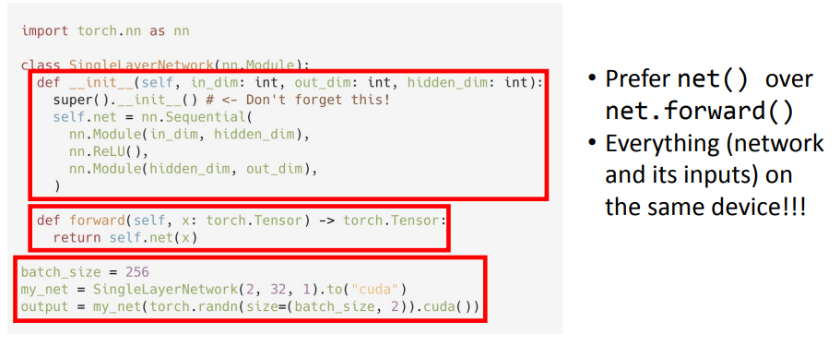
Custom networks
nn.Module represents the building blocks of a computation graph.
For example, in typical pytorch code, each convolution block is its own module, each fully connected block is a module, and the whole network itself is also a module.
Modules can contain modules within them. All the classes inside of `torch.nn` are instances `nn.Modules`.

Slide 23
Custom networks

Slide 24
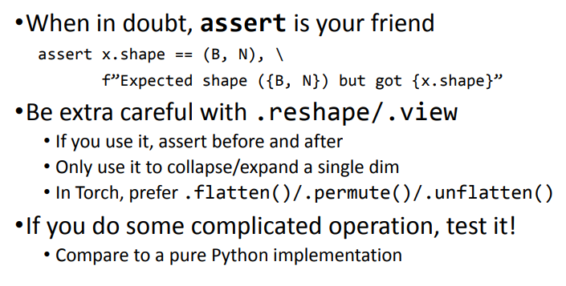
Torch Best Practices

Slide 25
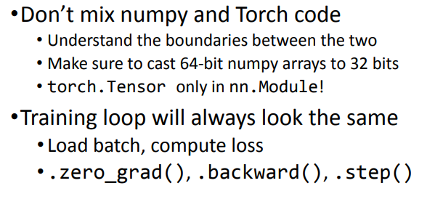
Torch Best Practices

Slide 26
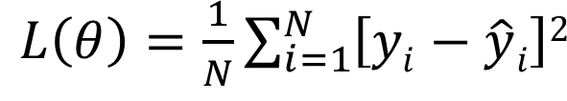
Neural network optimization
Mean squared error:
We want to minimize the square of the errors of the neural network estimates

Slide 27
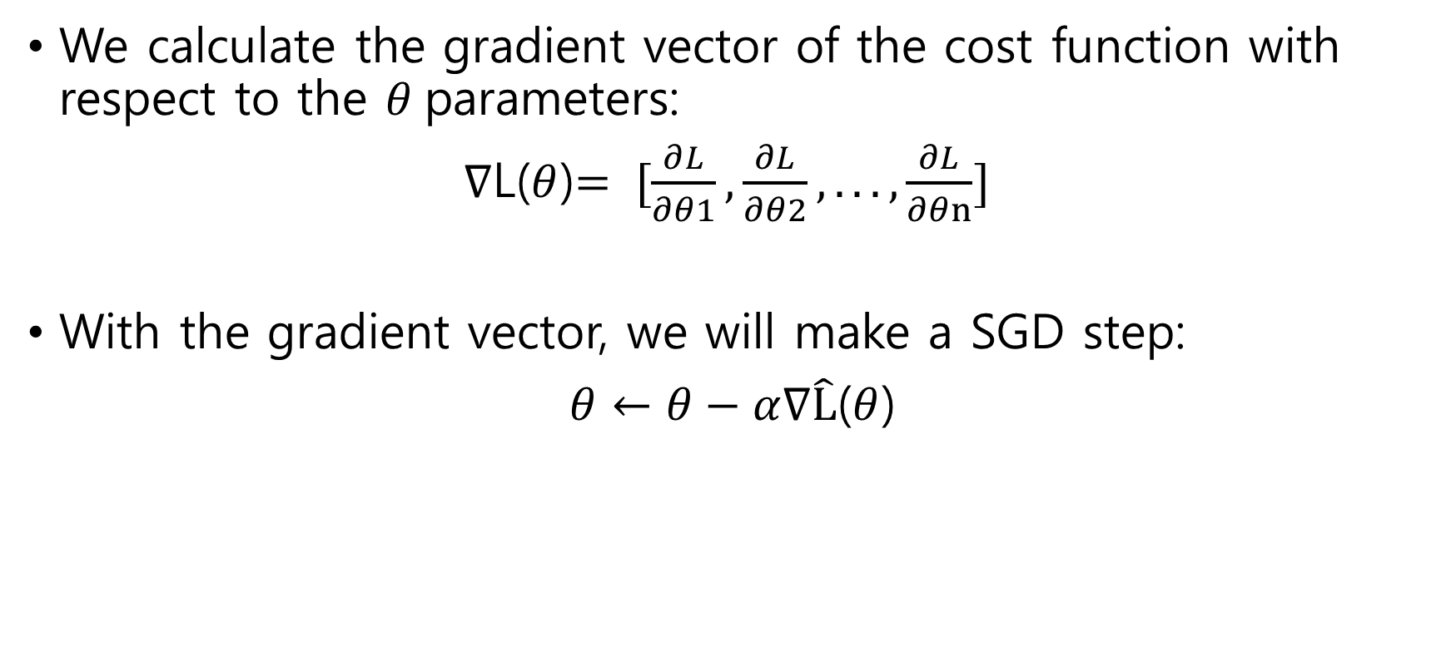
Neural network optimization
We calculate the gradient vector of the cost function with respect to the $θ$parameters:
$∇$L($θ$)$= [\frac{∂L}{∂θ1},\frac{∂L}{∂θ2},...,\frac{∂L}{∂θn}]$
With the gradient vector, we will make a SGD step:
$θ←θ−α∇\hat{L}$($θ$)

Slide 28
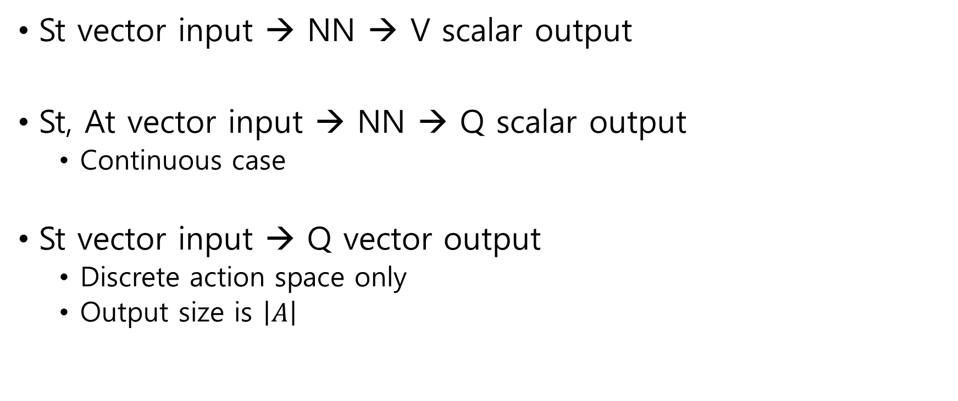
Neural Net. Architecture for V, Q
St vector input → NN → V scalar output
St, At vector input → NN → Q scalar output
Continuous case
St vector input → Q vector output
Discrete action space only
Output size is $\left|A\right|$

Slide 29
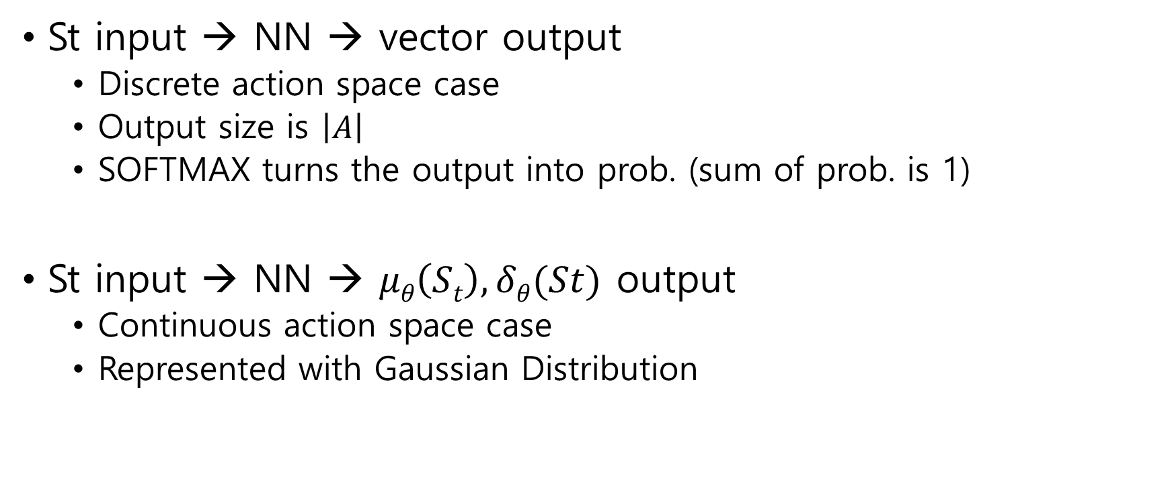
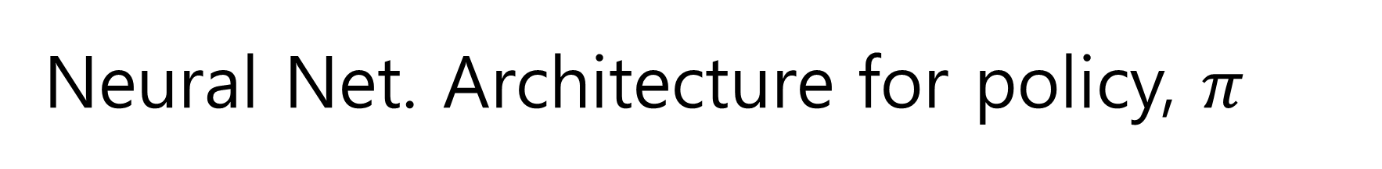
Neural Net. Architecture for policy, $π$
St input → NN → vector output
Discrete action space case
Output size is $\left|A\right|$
SOFTMAX turns the output into prob. (sum of prob. is 1)
St input → NN → $μθ\left(St\right), δθ(St)$ output
Continuous action space case
Represented with Gaussian Distribution

Slide 30
Deep SARSA

Slide 31
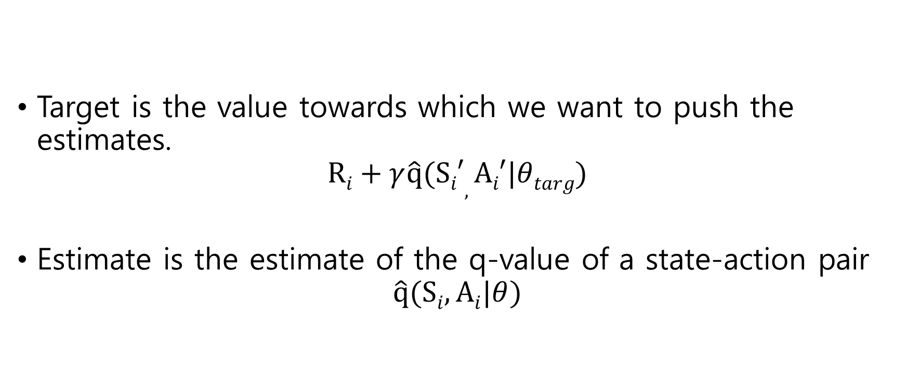
Neural network optimization
Target is the value towards which we want to push the estimates.
$$Ri+γ\hat{q}(Si′, Ai′|θtarg)$$
Estimate is the estimate of the q-value of a state-action pair
$$\hat{q}(Si, Ai|θ)$$

Slide 32
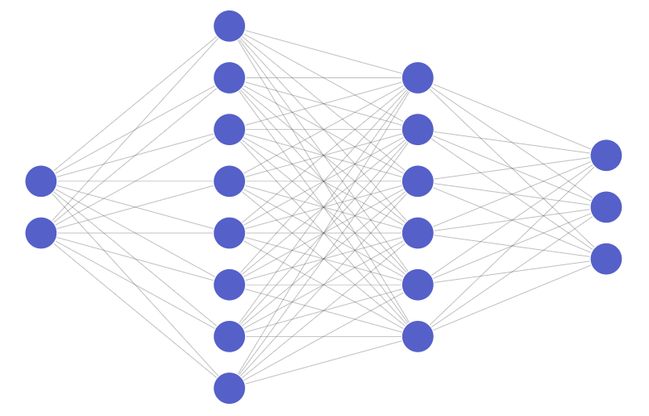
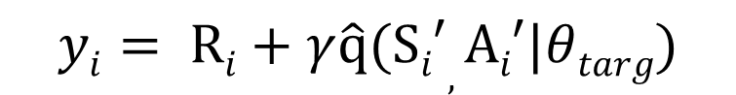
Target network
Function
approximator
Bootstrapping
$$yi= Ri+γ\hat{q}(Si′, Ai′|θtarg)$$

Slide 33
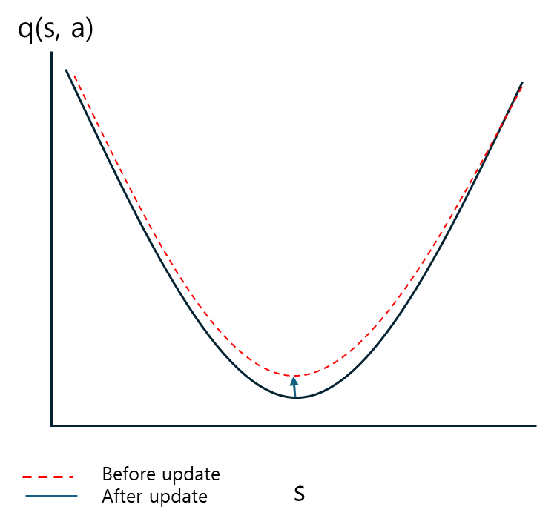
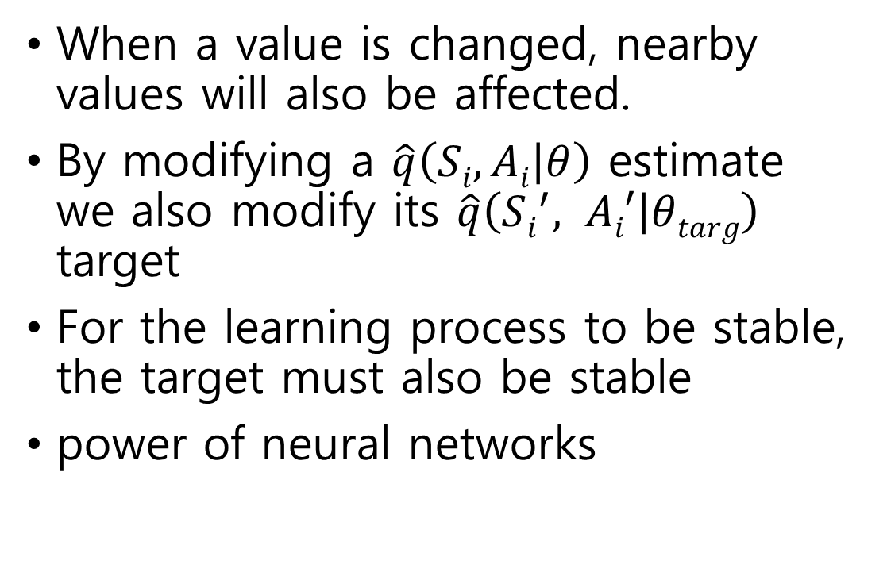
Target network
When a value is changed, nearby values will also be affected.
By modifying a $\hat{q}\left(Si, Ai | θ\right)$ estimate we also modify its $\hat{q}\left(Si^{′}, Ai′ | θtarg\right)$ target
For the learning process to be stable, the target must also be stable
power of neural networks

Slide 34
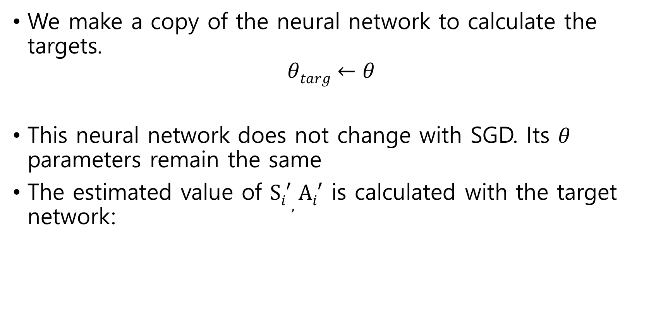
Target network
We make a copy of the neural network to calculate the targets.
$$θtarg←θ$$
This neural network does not change with SGD. Its $θ$ parameters remain the same
The estimated value of $Si′, Ai′$ is calculated with the target network:

Slide 35
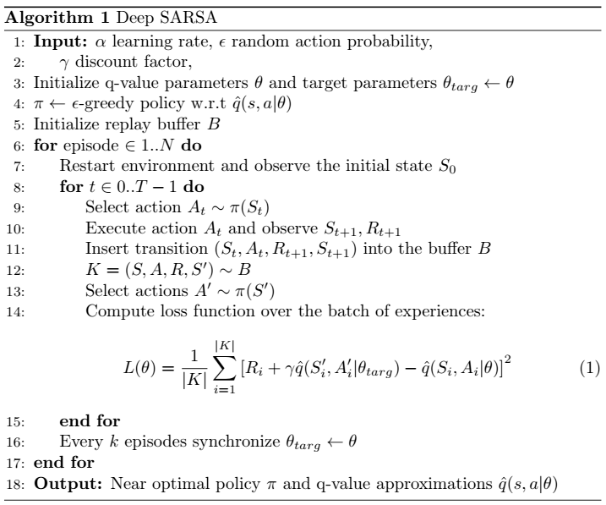
Neural network optimization

Slide 36

Experience Replay
Memory that stores the state transition that the agent experiences
The memory has a limited size and when it fills up, it replaces old transitions with new ones
B

Slide 37


Experience Replay
To update the neural network, we randomly chose a batch of transitions from the memory
The batch of transitions obtained from the memory is used to calculate the cost function and update the $θ$ parameters
B

Slide 38
Neural network optimization

Slide 39


Code Ex.
MountainCar: Reach the goal from the bottom of the valley

Slide 40
Code Ex.
deep_sarsa.ipynb

Slide 41
Deep Q-learning

Slide 42

Deep Q-learning
Q-learning + Neural Network
Swap the q-value table for a neural network
Tackle more difficult problems
Leverage generalization power of neural networks
S=[s1,s2]
$\hat{q}$= [$\hat{q}$(s,s₁), $\hat{q}$(s,s₂), $\hat{q}$(s,s₃)]

Slide 43
Neural Net. Architecture for V, Q
St vector input → NN → V scalar output
St, At vector input → NN → Q scalar output
Continuous case
St vector input → Q vector output
Discrete action space only
Output size is $\left|A\right|$

Slide 44

Neural Net. Architecture for policy, $π$
St input → NN → vector output
Discrete action space case
Output size is $\left|A\right|$
SOFTMAX turns the output into prob. (sum of prob. is 1)
St input → NN → $μθ\left(St\right), δθ(St)$ output
Continuous action space case
Represented with Gaussian Distribution

Slide 45

Neural network optimization
Mean squared error:
We calculate the gradient vector of the cost function with respect to the $θ$parameters:
$∇\hat{L}$($θ$)$= [\frac{∂L}{∂θ1},\frac{∂L}{∂θ2},...,\frac{∂L}{∂θn}]$
With the gradient vector, we will make a SGD step:
$θ←θ−α∇\hat{L}$($θ$)

Slide 46


Target network
Two techniques combined generate an unstable learning process.
Bootstrapping($yi= Ri+γ\hat{q}(Si′, Ai′|θtarg)$) + function approximator
Why? : When a value is changed, nearby values will also be affected.
When a value is changed, nearby values will also be affected.
By modifying a $\hat{q}\left(Si, Ai | θ\right)$ estimate we also modify its $\hat{q}\left(Si,′ Ai′ | θtarg\right)$ target
For the learning process to be stable, the target must also be stable

Slide 47

Target network
We make a copy of the neural network to calculate the targets.
$$θtarg←θ$$
This neural network does not change with SGD. Its $θ$ parameters remain the same
The estimated value of $Si′, Ai′$ is calculated with the target network:
$\hat{L}(θ)=\frac{1}{N}\sum_{i=0}^{N}{{[Ri+γ\hat{q}(Si′, Ai′|θtarg)−\hat{q}(Si, Ai|θ)]}^{2}}$

Slide 48



Deep Q-learning
Note that in SARSA A’~ $ε$-greedy policy. But in Q –learning A’~ argmax policy.
So, the target is equal to
R_{i}+$γ \max_{a′∈A}{\hat{q}(Si^{′}, Ai^{′}}$|$θtarg)$

Slide 49



Code Ex.
Cartpole: Keep the tip of the pole straight
If we know angle and velocity, we can calculate accelerations (Able to describe the whole dynamics)

Slide 50


Code Ex.

Slide 51


Code Ex.

Slide 52

Code Ex.
tensor([[-0.0220, -0.0468, 0.0114, -0.0126]])
Unsqueeze(dim=0) put an extra. dim. in front.
View(1,-1) put an extra. dim. in front.
tensor([[-0.0230, -0.2421, 0.0112, 0.2836]])
tensor([[1.]])
tensor([[False]])

Slide 53



Experience Replay
$[[S1, A1, R2, S2$], [$S2, A2, R3, S$₃]]
Zip object: parallel iteration:
Batch shape x State dim. (N x D)
[$\text{Tensor}\text{(}\text{N} \text{x} \text{D}\text{)},\text{Tensor}\text{(}\text{N} \text{x} \text{D}\text{)},\text{Tensor}\text{(}\text{N} \text{x} \text{D}\text{)}$]
→Torch.cat은 default가 행(0) 방향으로 붙임
S, A, R, 에 대해 각각 batch(N x D) 로 바꿔 줌

Slide 54







Deep Q-learning
Batch shape x State dim. (N x D)
[$\text{Tensor}\text{(}\text{N} \text{x} \text{D}\text{)},\text{Tensor}\text{(}\text{N} \text{x} \text{D}\text{)},\text{Tensor}\text{(}\text{N} \text{x} \text{D}\text{)}$]
→Torch.cat은 default가 행(0) 방향으로 붙임
S, A, R, 에 대해 각각 batch(N x D) 로 바꿔 줌
_{각 state당 액션의 개수만큼 output이 나옴.}
,
$e$.g., $\left[\left[(\hat{q}\left(s1, a1\right)\right], \left[\hat{q}\left(s1, a2 \right)\right]\right]$
$\hat{q}\left(Si,′ Ai′ | θtarg\right)$, where $Ai′$ $\sim π\left(S^{′}\right)$
$$\hat{L}(θ)=\frac{1}{N}\sum_{i=0}^{N}{{[Ri+γ\hat{q}(Si′, Ai′|θtarg)−\hat{q}(Si, Ai|θ)]}^{2}}$$
$∇\hat{L}$($θ$)$= [\frac{∂L}{∂θ1},\frac{∂L}{∂θ2},...,\frac{∂L}{∂θn}]$
$θ←θ−α∇\hat{L}$($θ$)

Slide 55
Code Ex.
Open deep_q_learning.ipynb

